Slide 1



Noida Institute of Engineering and Technology, Greater Noida
Memory Unit
Unit: 4
Computer Organization & Architecture
Swarnima
CS (AIML)
Department
B Tech 3rd Sem
Swarnima COA 4

Slide 2
Content
Memory:
Basic concept and hierarchy
semiconductor RAM memories
2D & 2 1/2D memory organization
ROM memories
Cache memories: concept and design issues & performance
address mapping and replacement
Auxiliary memories: magnetic disk, magnetic tape and
optical disks
Virtual memory: concept implementation
.
Swarnima COA 4

Slide 3
Course Objective
Study the various memory used by computer like hierarchical memory system, RAM, ROM, 2D & 2 1/2D memory organization.
Study of Cache memories and virtual memory , Auxiliary memories: magnetic disk, magnetic tape and optical disks .
Swarnima COA 4

Slide 4
Course Outcome
Understanding the hierarchical memory system, cache memories and virtual memory
Swarnima COA 4

Slide 5
CO-PO Mapping
COMPUTER ORGANIZATION AND ARCHITECTURE (KCS-302)
CO.K | PO1 | PO2 | PO3 | PO4 | PO5 | PO6 | PO7 | PO8 | PO9 | PO10 | PO11 | PO12
KCS-302.4 | 3 | 2 | 2 | 2 | 2 | 1 | 1 | 1 | 1 | 1 | 1 | 2
Swarnima COA 4

Slide 6
CO- PSO Mapping
COMPUTER ORGANIZATION AND ARCHITECTURE (KCS-302)
CO.K | PSO1 | PSO2 | PSO3 | PSO4
KCS-302.2 | 2 | 3 | 3 | 2
Swarnima COA 4

Slide 7
Memory
A Memory Unit is a collection of storage cells together with associated circuits needed to transfer information in and out of storage.
The memory stores binary information(1's and 0's) in groups of bits called words. A storage element is called a Cell.
A group of eight bits is called a byte. Most computer memories use words whose number of bits is a multiple of 8.
The capacity of memories in commercial computers is usually stated as the total number of bytes that can be stored.
Swarnima COA 4

Slide 8
Prerequisite and Recap
Basics of Computer Organization & architecture
Functional unit and their interconnection
Swarnima COA 4

Slide 9
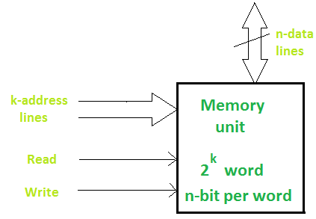
Memory
A memory unit consists of data lines, address selection lines, and control lines that specify the direction of transfer. The block diagram of a memory unit is shown below:
Data lines provide the information to be stored in memory. The control inputs specify the direction transfer.
The k-address lines specify the word chosen. When there are k address lines, 2^{k} memory word can be accessed.
Swarnima COA 4

Slide 10
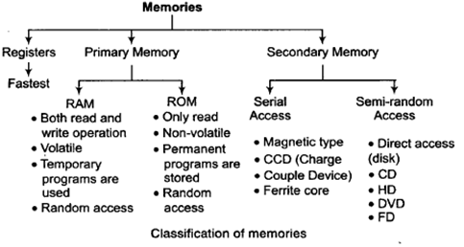
Classification of Memory
Swarnima COA 4

Slide 11
Memory Hierarchy
The memory hierarchy system consists of all storage devices contained in a computer system from the slow Auxiliary Memory to fast and to smaller Cache memory and Register.
The typical access time ratio between cache and main memory is about 1 to 7.
Auxiliary memory access time is generally 1000 times that of the main memory, hence it is at the bottom of the hierarchy.
The Memory Hierarchy was developed based on a program behavior known as locality of references.
Swarnima COA 4

Slide 12
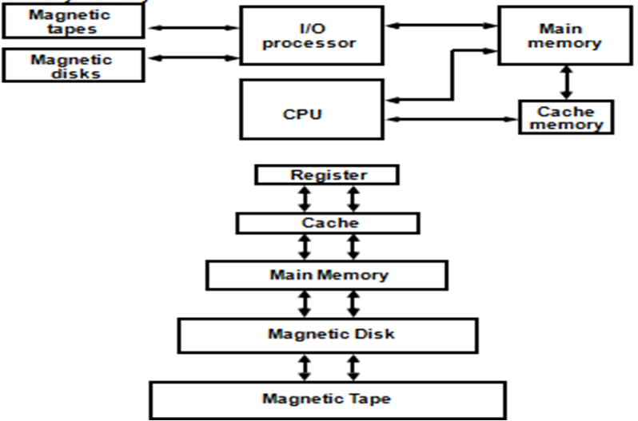
Memory Hierarchy
Swarnima COA 4

Slide 13
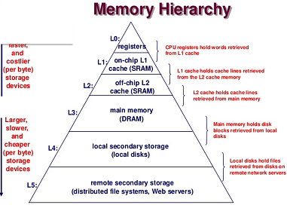
Memory Hierarchy
Swarnima COA 4

Slide 14
Semiconductor RAM
RAM (Random Access Memory) is a part of computer’s Main Memory which is directly accessible by CPU.
RAM is used to Read and Write data into it which is accessed by CPU randomly. RAM is volatile in nature.
RAM is used to store the data that is currently processed by the CPU.
Integrated RAM chips are available in two form:
SRAM(Static RAM)
DRAM(Dynamic RAM)
Swarnima COA 4

Slide 15
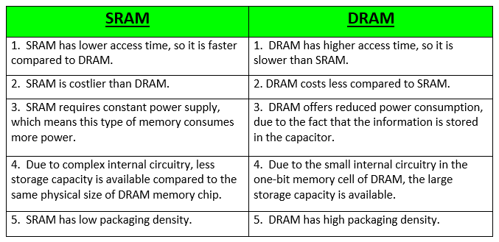
SRAM Vs. DRAM
The block diagram of RAM chip is given below.
Swarnima COA 4

Slide 16
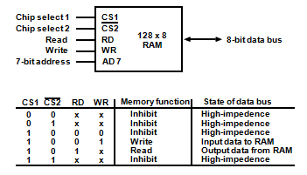
Semiconductor RAM
The block diagram of RAM chip is given below.
Swarnima COA 4

Slide 17
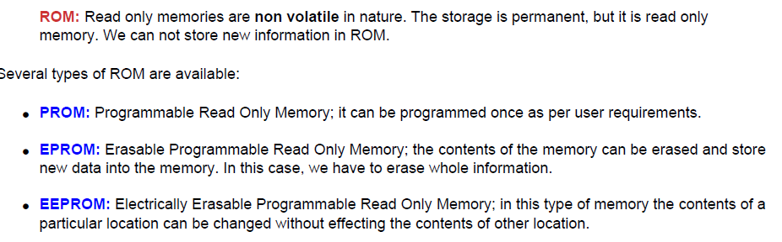
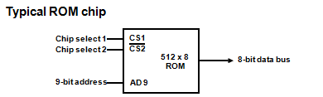
ROM Memory
Swarnima COA 4

Slide 18
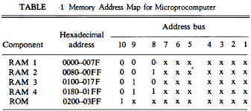
Memory Address Map
The interconnection between memory and processor is then established from knowledge of the size of memory needed and the type of RAM and ROM chips available.
The addressing of memory can be established by means of a table that specifies the memory address assigned to each chip. The table, called a memory address map
Swarnima COA 4

Slide 19
Memory Connection to CPU
RAM and ROM chips are connected to a CPU through the data and address buses. The low-order lines in the address bus select the byte within the chips and other lines in the address bus select a particular chip through its chip select inputs.
This configuration gives a memory capacity of 512 bytes of RAM and 512 bytes of ROM. It implements the memory map
Swarnima COA 4

Slide 20
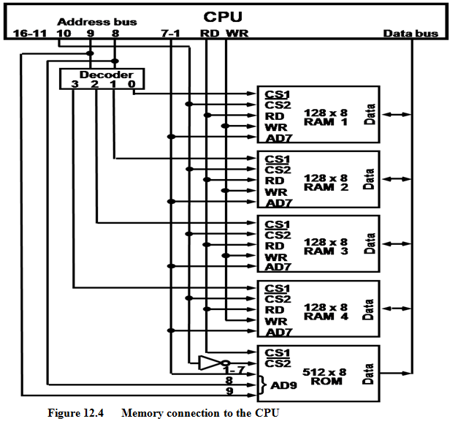
Memory Connection to CPU
Swarnima COA 4

Slide 21
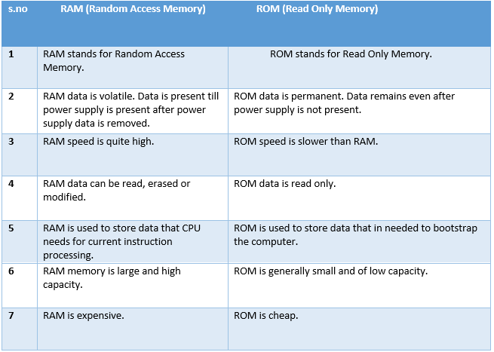
RAM Vs.ROM
Swarnima COA 4

Slide 22
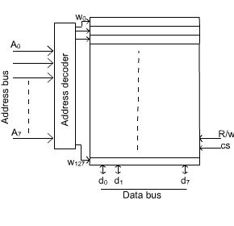
Organization of Memory Chips
The memory is organized in the form of a cell, each cell is able to be identified with a unique number called address.
Each cell is able to recognize control signals such as “read” and “write”, generated by CPU when it wants to read or write address.
Swarnima COA 4

Slide 23
2D and 2.5D Memory organization
2D Memory organization
In 2D organization memory is divides in the form of rows and columns. Each row contains a word now in this memory organization there is a decoder.
A decoder is a combinational circuit which contains n input lines and 2^{n} output lines.
One of the output line will select the row which address is contained in the MAR.
The word which is represented by the row that will get selected and either read or write through the data lines.
Swarnima COA 4

Slide 24
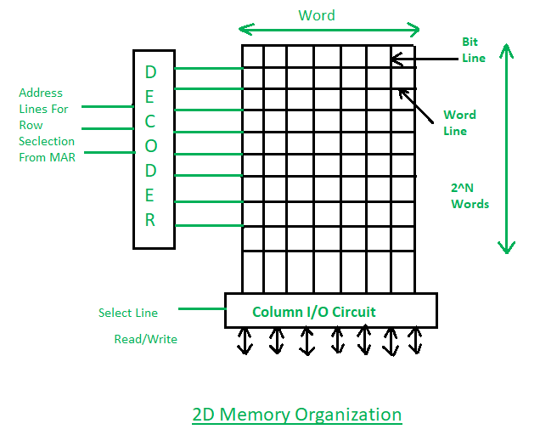
2D and 2.5D Memory organization
2D Memory organization
Swarnima COA 4

Slide 25
2D and 2.5D Memory organization
2.5 D Memory organization
In 2.5D Organization the scenario is the same but we have two different decoders one is column decoder and another is row decoder.
Column decoder used to select the column and row decoder is used to select the row. Address from the MAR will go in decoders’ input.
Decoders will select the respective cell. Through the bit outline, the data from that location will be read or through the bit in line data will be written at that memory location.
Swarnima COA 4

Slide 26
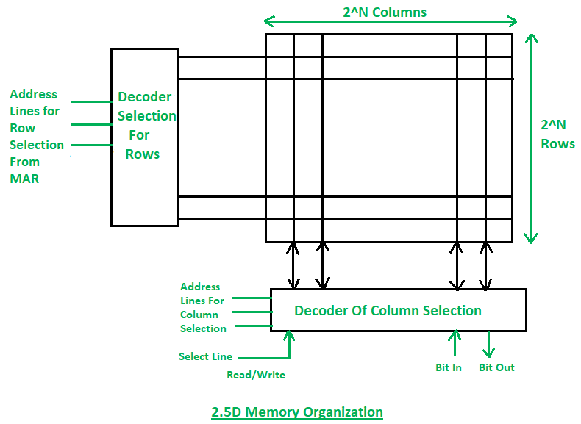
2D and 2.5D Memory organization
2.5D Memory organization
Swarnima COA 4

Slide 27
2D and 2.5D Memory organization
Read and Write Operations
If the select line is in Read mode then the Word/bit which is represented by the MAR that will be coming out to the data lines and get read.
If the select line is in write mode then the data from memory data register (MDR) will go to the respective cell which is addressed by the memory address register (MAR).
With the help of the select line the data will get selected where the read and write operations will take place.
Swarnima COA 4

Slide 28
2D and 2.5D Memory organization
Comparison between 2D & 2.5D Organizations
In 2D organization hardware is fixed but in 2.5D hardware changes.
2D Organization requires more no. of Gates while 2.5D requires less no. of Gates.
2D is more complex in comparison to the 2.5D Organization.
Error correction is not possible in the 2D organization but In 2.5D error correction is easy.
2D is more difficult to fabricate in comparison to the 2.5D organization.
Swarnima COA 4

Slide 29
Cache Memory
The references to memory at any given interval of time tend to be confined within a few localized areas in memory. This phenomenon is known as the property of locality of reference.
If the active portions of the program and data are placed in a fast small memory, the average memory access time can be reduced, thus reducing the total execution time of the program. Such a fast small memory is referred to as a cache memory.
Cache Memory is a special very high-speed and small memory. It is used to speed up and synchronizing with high-speed CPU.
Cache memory is costlier than main memory or disk memory but economical than CPU registers.
Cache memory acts as a buffer between RAM and the CPU. It holds frequently requested data and instructions so that they are immediately available to the CPU when needed.
Swarnima COA 4

Slide 30
Cache Memory
Cache memory is used to reduce the average time to access data from the Main memory.
The cache stores copies of the data from frequently used main memory locations.
When the CPU needs to access memory, the cache is examined. If the word is found in the cache, it is read from the fast memory. If the word addressed by the CPU is not found in the cache, the main memory is accessed to read the word.
Swarnima COA 4

Slide 31
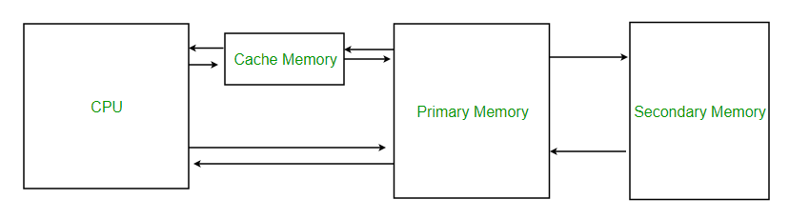
Cache Memory
Position of cache memory
Cache Performance: The performance of cache memory is frequently measured in terms of a quantity called hit ratio .
When the CPU refers to memory and finds the word in cache, it is said to produce a hit .
If the word is not found in cache, it is in main memory and it counts as a miss .
The ratio of the number of hits divided by the total CPU references to memory (hits plus misses) is the hit ratio.
Hit ratio = hit / (hit + miss)
Swarnima COA 4

Slide 32
Cache Memory
For example:
A computer with cache access time of 100 ns, a main memory access time of 1000 ns, and a hit ratio of 0.9 produces an average access time of 200 ns. This is a considerable improvement over a similar computer without a cache memory, whose access time is 1000 ns.
Swarnima COA 4

Slide 33
Cache Memory Mapping
Cache Mapping: The transformation of data from main memory to cache memory is referred to as a mapping process.
There are three different types of mapping used for the purpose of cache memory which are as follows:
Associative mapping
Direct mapping
Set-Associative mapping.
To understand all these three mapping procedures we consider an example.
Swarnima COA 4

Slide 34
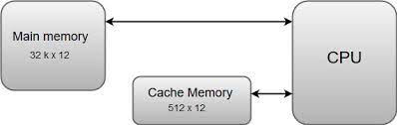
Cache Memory Mapping
The main memory can store 32K words of 12 bits each. The cache is capable of storing 512 of these words at any given time.
It first sends a 15-bit address to cache. If there is a hit, the CPU accepts the 12-bit data from cache. If there is a miss, the CPU reads the word from main memory and the word is then transferred to cache.
Swarnima COA 4

Slide 35
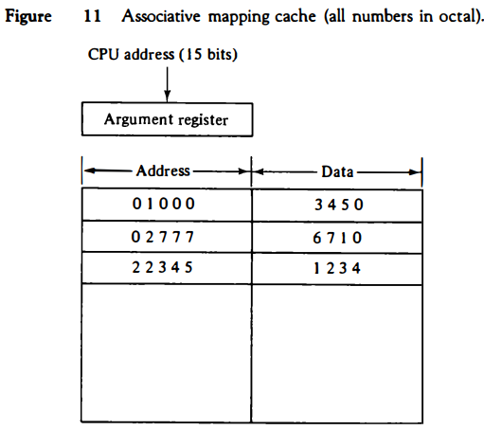
Associative Mapping
The address value of 15 bits is shown as a five-digit octal number and its corresponding 12 -bit word is shown as a four-digit octal number. A CPU address of 15 bits is placed in the argument register and the associative memory is searched for a matching address.
Swarnima COA 4

Slide 36
Direct Mapping
When the CPU generates a memory request, the index field is used for the address to access the cache. The tag field of the CPU address is compared with the tag in the word read from the cache.
If the two tags match, there is a hit and the desired data word is in cache. If there is no match, there is a miss and the required word is read from main memory.
For example:
The word at address zero is presently stored in the cache (index = 000, tag = 00, data = 1220). Suppose that the CPU now wants to access the word at address 02000. The index address is 000, so it is used to access the cache. The two tags are then compared. The cache tag is 00 but the address tag is 02, which does not produce a match. Therefore, the main memory is accessed and the data word 5670 is transferred to the CPU. The cache word at index address 000 is then replaced with a tag of 02 and data of 5670.
Swarnima COA 4

Slide 37
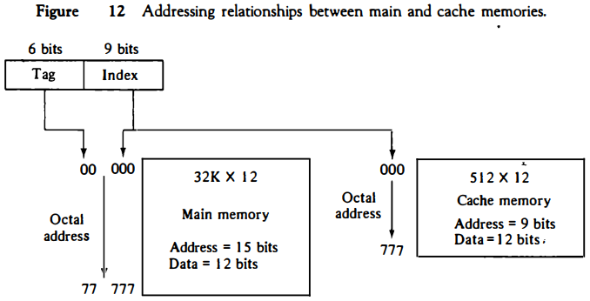
Direct Mapping
Swarnima COA 4

Slide 38
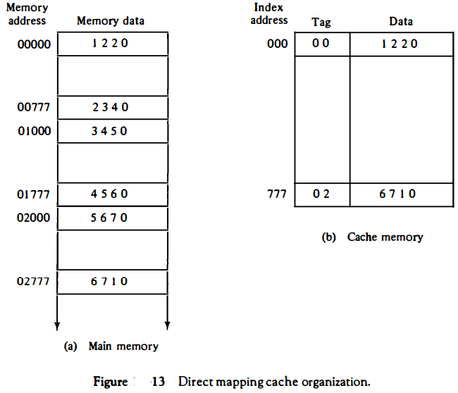
Cache Memory Mapping
Swarnima COA 4

Slide 39
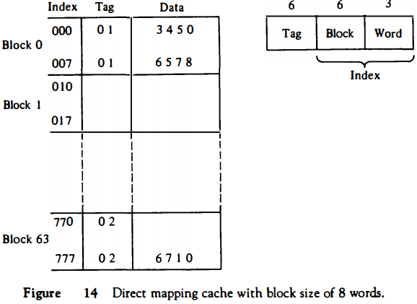
Cache Memory Mapping
The block number is specified with a 6-bit field and the word within the block
is specified with a 3-bit field. The tag field stored within the cache is common
to all eight words of the same block. Every time a miss occurs, an entire block
of eight words must be transferred from main memory to cache memory.
Swarnima COA 4

Slide 40
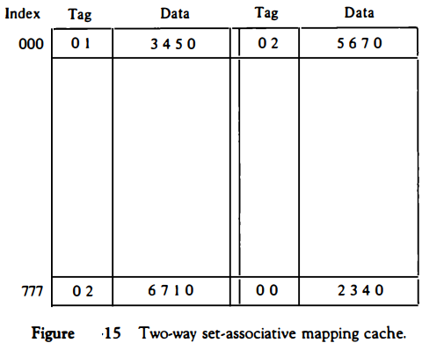
Cache Memory Mapping
Swarnima COA 4

Slide 41
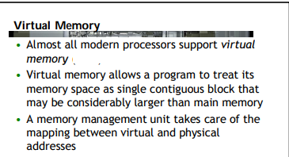
Virtual Memory
Swarnima COA 4

Slide 42
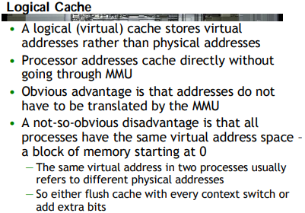
Virtual Memory
Swarnima COA 4

Slide 43
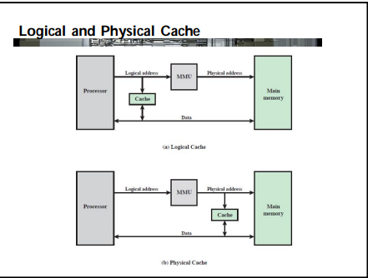
Virtual Memory
Swarnima COA 4

Slide 44
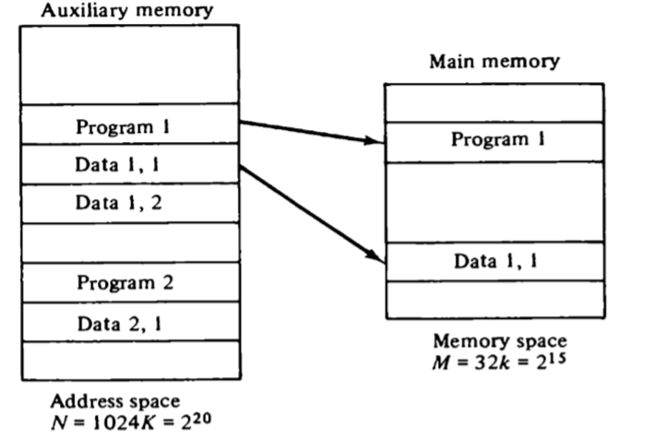
Virtual Memory
Swarnima COA 4

Slide 45
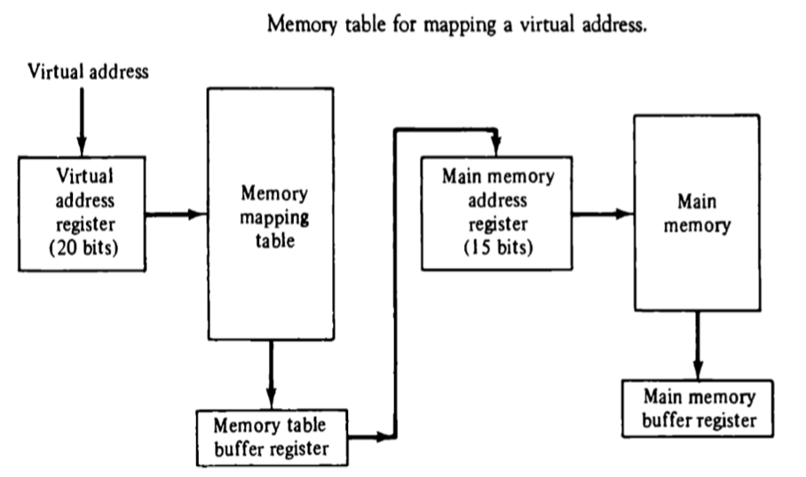
Virtual Memory
Swarnima COA 4

Slide 46
Page Replacement Algorithm
Page replacement is a process of swapping out an existing page from the frame of a main memory and replacing it with the required page.
Page Replacement Algorithms-
Page replacement algorithms help to decide which page must be swapped out from the main memory to create a room for the incoming page.
FIFO Page Replacement Algorithm
LIFO Page Replacement Algorithm
LRU Page Replacement Algorithm
Optimal Page Replacement Algorithm
A good page replacement algorithm is one that minimizes the number of page faults.
Swarnima COA 4

Slide 47
Page Replacement Algorithm
FIFO Page Replacement Algorithm-
As the name suggests, this algorithm works on the principle of “First in First out“.
It replaces the oldest page that has been present in the main memory for the longest time. It is implemented by keeping track of all the pages in a queue.
Example
A system uses 3 page frames for storing process pages in main memory. It uses the FIFO page replacement policy. Assume that all the page frames are initially empty. What is the total number of page faults, hit ratio and miss ratio and page reference string given below-
4 , 7, 6, 1, 7, 6, 1, 2, 7, 2
Swarnima COA 4

Slide 48
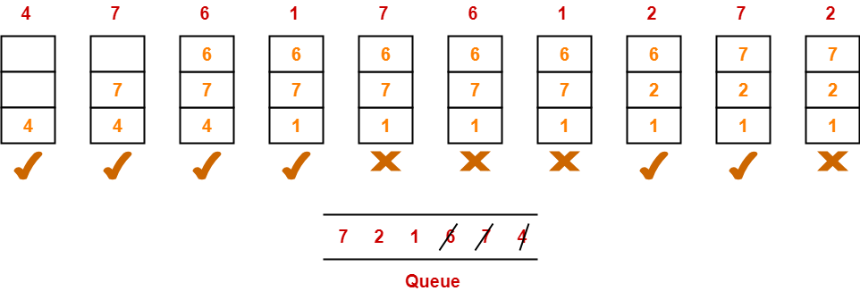
FIFO Replacement Algorithm
Solution-
Total number of references = 10
Total number of page faults occurred = 6
Total number of page hits
= Total number of references – Total number of page misses or page faults
= 10 – 6 = 4
Thus, Hit ratio = 4 / 10 = 0.4 or 40%, Miss ratio = 6 / 10 = 0.6 or 60%
Swarnima COA 4

Slide 49
LIFO Page Replacement Algorithm
LIFO Page Replacement Algorithm-
This algorithm works on the principle of “Last in First out“.
It replaces the newest page that arrived at last in the main memory.
It is implemented by keeping track of all the pages in a stack.
Example
A system uses 3 page frames for storing process pages in main memory. It uses the LIFO page replacement policy. Assume that all the page frames are initially empty. What is the total number of page faults, hit ratio and miss ratio and page reference string given below-
4 , 7, 6, 1, 7, 6, 1, 2, 7, 2
Swarnima COA 4

Slide 50
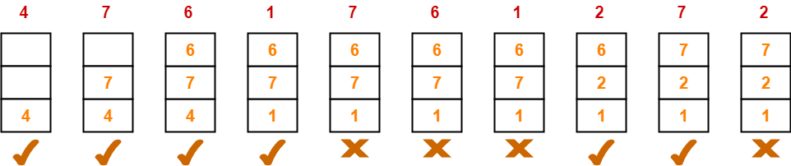
LIFO Page Replacement Algorithm
Solution-
Total number of references = 10
Total number of page faults occurred = 6
Total number of page hits
= Total number of references – Total number of page misses or page faults
= 10 – 6 = 4
Thus, Hit ratio = 4 / 10 = 0.4 or 40%, Miss ratio = 6 / 10 = 0.6 or 60%
Swarnima COA 4

Slide 51
Optimal Replacement Algorithm
Optimal Page Replacement Algorithm-
This algorithm replaces the page that will not be referred by the CPU in future for the longest time.
It is practically impossible to implement this algorithm.
However, it is the best known algorithm and gives the least number of page faults.
Hence, it is used as a performance measure criterion for other algorithms.
Example
A system uses 3 page frames for storing process pages in main memory. It uses the Optimal page replacement policy. Assume that all the page frames are initially empty. What is the total number of page faults, hit ratio and miss ratio and page reference string given below-
4 , 7, 6, 1, 7, 6, 1, 2, 7, 2
Swarnima COA 4

Slide 52
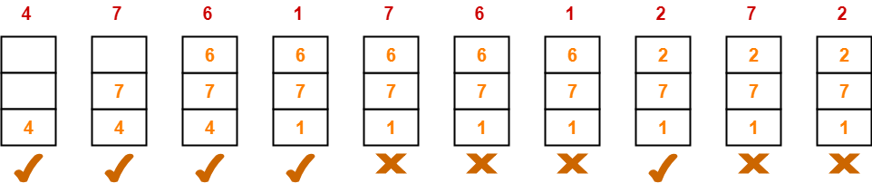
Optimal Page Replacement Algorithm
Solution-
Total number of references = 10
Total number of page faults occurred = 5
Total number of page hits
= Total number of references – Total number of page misses or page faults
= 10 – 5 = 5
Thus, Hit ratio = 5 / 10 = 0.5 or 50%, Miss ratio = 5 / 10 = 0.5 or 50%
Swarnima COA 4

Slide 53
Auxiliary Memories
Auxiliary memory (also referred to as secondary storage) is the non-volatile memory lowest-cost, highest-capacity, and slowest-access storage in a computer system.
It is where programs and data kept for long-term storage or when not in immediate use. It is not directly accessible by the CPU. For example:
Magnetic disks and tapes, Optical Disk.
Secondary Storage Media
There are the following main types of storage media:
1. Magnetic storage media:
Magnetic media is coated with a magnetic layer which is magnetized in clockwise or anticlockwise directions. When the disk moves, the head interprets the data stored at a specific location in binary 1s and 0s at reading.
Examples: hard disks, floppy disks and magnetic tapes.
Swarnima COA 4

Slide 54
Auxiliary Memories
Floppy Disk: A floppy disk is a flexible disk with a magnetic coating on it. It is packaged inside a protective plastic envelope.
Hard disk: A hard disk consists of one or more circular disks called platters which are mounted on a common spindle. Each surface of a platter is coated with a magnetic material.
2. Optical storage media
In optical storage media information is stored and read using a laser beam. The data is stored as a spiral pattern of pits and ridges denoting binary 0 and binary 1.
Examples: CDs and DVDs
Compact Disk: A Compact Disc drive(CDD) is a device that a computer uses to read data that is encoded digitally on a compact disc(CD). A compact disk or CD can store approximately 650 to 700 megabytes of data.
Swarnima COA 4

Slide 55
Auxiliary Memories
DVD:
It stands for Digital Versatile Disk or Digital Video Disk. It looks just like a CD and use a similar technology as that of the CDs but allows tracks to be spaced closely enough to store data that is more than six times the CD’s capacity.
It is a significant advancement in portable storage technology. A DVD holds 4.7 GB to 17 GB of data.
Blue Ray Disk:
This is the latest optical storage media to store high definition audio and video. It is similar to a CD or DVD but can store up to 27 GB of data on a single layer disk and up to 54 GB of data on a dual layer disk.
While CDs or DVDs use red laser beam, the blue ray disk uses a blue laser to read/write data on a disk.
Swarnima COA 4

Slide 56

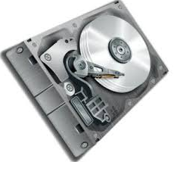


Auxiliary Memories
Example of Auxiliary Memories
DVD
CD
Hard Disk
Swarnima COA 4

Slide 57
Limitations of Memory System Performance
• Memory system, and not processor speed, is often the bottleneck for many applications.
• Memory system performance is largely captured by two parameters, latency and bandwidth.
• Latency is the time from the issue of a memory request to the time the data is available at the processor.
• Bandwidth is the rate at which data can be pumped to the processor by the memory system.
Swarnima COA 4

Slide 58
Memory System Performance:
Bandwidth and Latency
• It is very important to understand the difference between latency and bandwidth.
• Consider the example of a fire-hose. If the water comes out of the hose two seconds after the hydrant is turned on, the latency of the system is two seconds.
• Once the water starts flowing, if the hydrant delivers water at the rate of 5 gallons/second, the bandwidth of the system is 5 gallons/second.
• If you want immediate response from the hydrant, it is important to reduce latency.
• If you want to fight big fires, you want high bandwidth.
Swarnima COA 4

Slide 59
Memory bandwidth
Memory bandwidth is the rate at which data can be read from or stored into a semiconductor memory by a processor.
Memory bandwidth is usually expressed in units of bytes/second, though this can vary for systems with natural data sizes that are not a multiple of the commonly used 8-bit bytes.
Memory bandwidth that is advertised for a given memory or system is usually the maximum theoretical bandwidth.
In practice the observed memory bandwidth will be less than (and is guaranteed not to exceed) the advertised bandwidth.
A variety of computer benchmarks exist to measure sustained memory bandwidth using a variety of access patterns. These are intended to provide insight into the memory bandwidth that a system should sustain on various classes of real applications.
Swarnima COA 4

Slide 60
Memory bandwidth
Memory latency is the time (the latency) between initiating a request for a byte or word in memory until it is retrieved by a processor.
If the data are not in the processor's cache, it takes longer to obtain them, as the processor will have to communicate with the external memory cells. Latency is therefore a fundamental measure of the speed of memory: the less the latency, the faster the reading operation.
Latency should not be confused with memory bandwidth, which measures the throughput of memory.
Latency can be expressed in clock cycles or in time measured in nanoseconds. Over time, memory latencies expressed in clock cycles have been fairly stable, but they have improved in time.
Swarnima COA 4

Slide 61
Faculty Video Links, You tube Courses Details
You tube/other Video Links
https://www.youtube.com/watch?v=NVUWlO5zsk0
https://www.youtube.com/watch?v=zwovvWfkuSg
https://www.youtube.com/watch?v=m1dA7D6c3C0
https://www.youtube.com/watch?v=o2_iCzS9-ZQ
https://www.youtube.com/watch?v=pJ6qrCB8pDw&list=PLIY8eNdw5tW-BxRY0yK3fYTYVqytw8qhp
Swarnima COA 4

Slide 62
Daily Quiz
Sketch memory hierarchy .
Sketch 2.5D RAM organization.
Write some differences between SRAM and DRAM.
What do mean by virtual memory in COA.
Which page replacement algorithm is good & why ?
Swarnima COA 4

Slide 63
Weekly Assignment
Explain memory hierarchy with suitable diagram.
Analysis different mapping scheme of cache memory.
Discuss 2 D RAM and 2+1/2D RAM with suitable diagram.
Write short notes on-
a) Cache Memory b) Associative Memory c) Auxiliary Memory
Explain the method to improve the performance of cache memory.
Swarnima COA 4

Slide 64
MCQ
1 Which of the following is the fastest means of memory access for CPU?
a) Registers b) Cache c) Main memory d) Virtual Memory
2. Size of the ____memory mainly depends on the size of the address bus.
a) Main b) Virtual c) Secondary d) Cache
3. What is the location of the internal registers of CPU?
a) Internal b) On-chip c) External d) Motherboard
4. MAR stands for ___________
5. Which of the following is non-volatile storage?
a) Backup b) Secondary c) Primary d) Cache
6. Which of the following is used in main memory?
a) SRAM b) DRAM c) PRAM d) DDR
7. RAID stands for __________
Solution 1 b. 2a. 3 b. 4 Memory address register. 5 b 6 b
7 Redundant array of independent disks
Swarnima COA 4

Slide 65
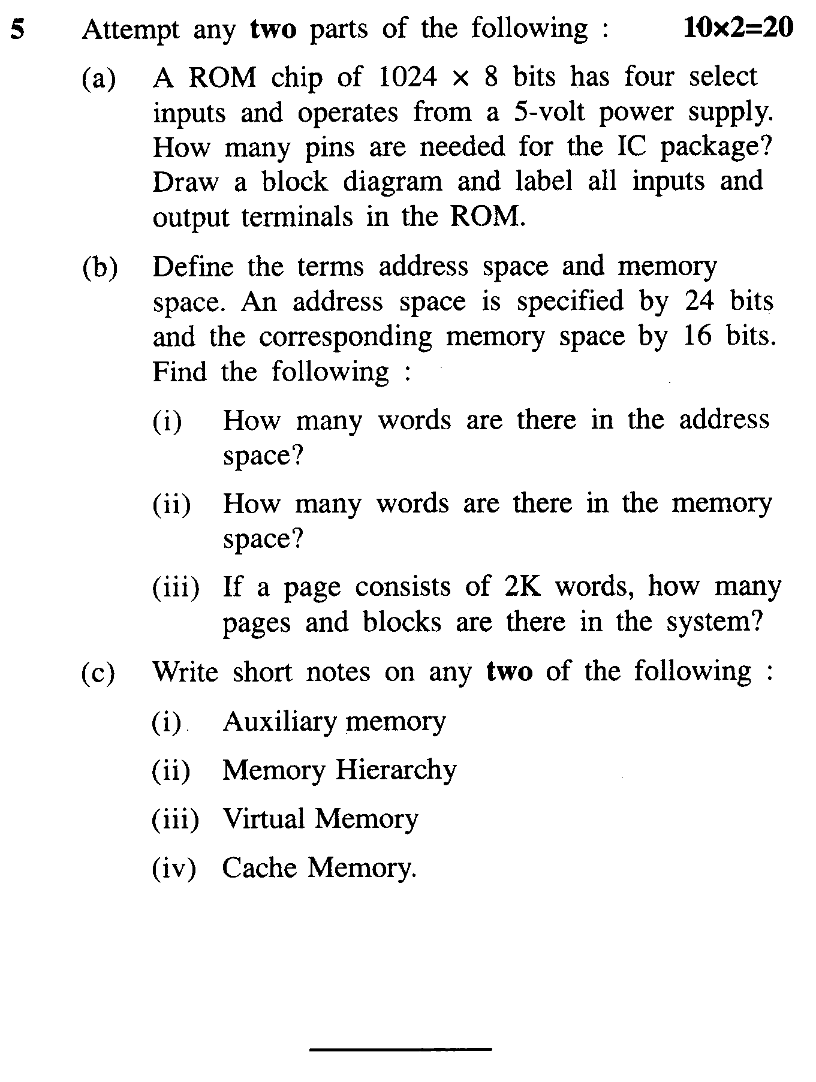
Old Question Papers
Swarnima COA 4

Slide 66
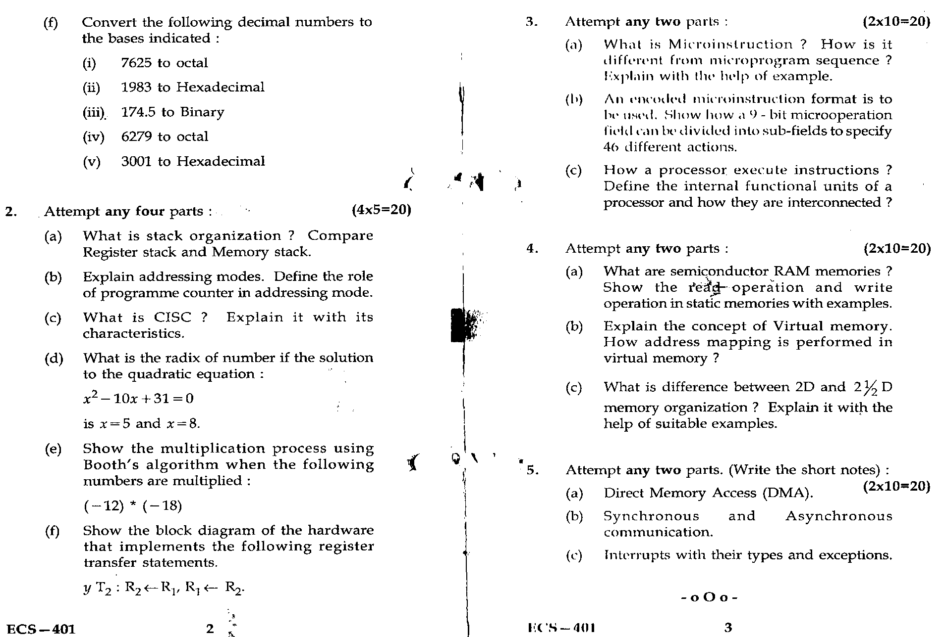
Old Question Papers
Swarnima COA 4

Slide 67
Expected Questions for University Exam
Describe CAM in memory unit with major characteristics
with suitable diagram.
A computer uses RAM chips of 1024*1 capacity.
i) How many chips are needed & how should their address lines be
connected to provide a memory capacity of 1024*8 ?
ii) How many chips are needed to provide a memory capacity of
16KB ?
Calculate the page fault for a given string with the help of LRU & FIFO
page replacement algorithm, Size of frames = 4 and
string 1 2 3 4 2 1 5 6 2 1 2 3 7 6 3 2 1 2 3 6
Explain Memory hierarchy with suitable diagram.
Define Direct and Set associative mapping in a cache memory.
Swarnima COA 4

Slide 68
Summary
In previous slides we discuss in details
Memory Unit:
Basic concept and hierarchy
semiconductor RAM memories
2D & 2 1/2D memory organization
ROM memories
Cache memories: concept and design issues & performance
address mapping and replacement
Auxiliary memories: magnetic disk, magnetic tape and
optical disks
Virtual memory: concept implementation
Swarnima COA 4

